Slide 1
Investment Analysis using POWER BI Date: 29th June, 2025 Prepared by: PAROMITA SAHA

Slide 2

AGENDA
Executive Summary
Project Objectives
Methodology
Task 1: Data Exploration and Summary
Task 2: Gender-based Analysis
Task 3: Objective Analysis
Task 4: Investment Duration & Frequency
Task 5: Reasons for Investment
Task 6: Source of Information
Task 7: Combine Insights into Dashboard
Conclusions
Recommendation

Slide 3

Executive Summary
This report details a comprehensive investment analysis project conducted to understand investor behavior, preferences, and the factors influencing investment decisions. The project involved data exploration, gender-based analysis, objective analysis, duration and frequency analysis, reasons for investment, and sources of information, culminating in a combined insights dashboard.

Slide 4
Project Objective
The primary objectives of this project were to:
Understand and summarize key statistics within the investment dataset.
Analyze gender-based differences in investment preferences.
Explore the relationship between savings objectives and investment choices.
Analyze investment durations and monitoring frequencies.
Identify common trends in reasons for investment.
Analyze the sources from which individuals gather investment information.
Create a comprehensive dashboard incorporating all derived insights.

Slide 5
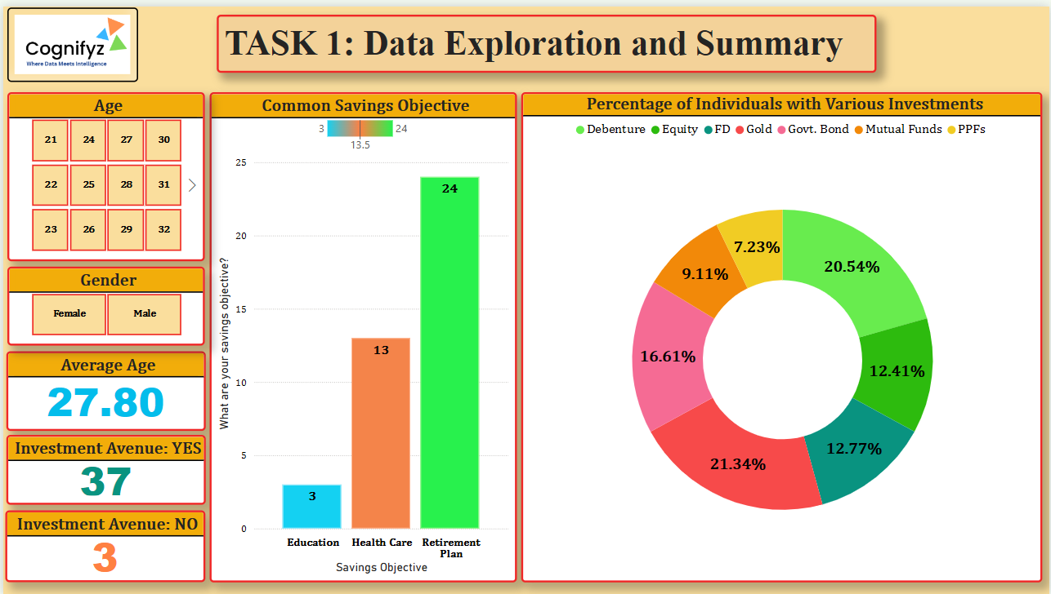
Methodology
The project followed a structured approach, utilizing Power BI Desktop for data import, exploration, calculation, and visualization. Each task involved specific steps as outlined below:
Task 1: Data Exploration and Summary
Key Findings:
Average Age: 27.80 years.
Percentage of individuals with various investments: Equity (20.54%), Mutual Funds (21.34%), PPFs (12.77%), Fixed Deposits (16.61%), Debentures (7.23%), Gold (9.11%), Govt. Bonds (12.41%).
Common Savings Objectives: Retirement Plan (60%), Education (32.5%), Health Care (7.5%).
Investment Avenue: Yes (37 investors), No (3 investors).

Slide 6
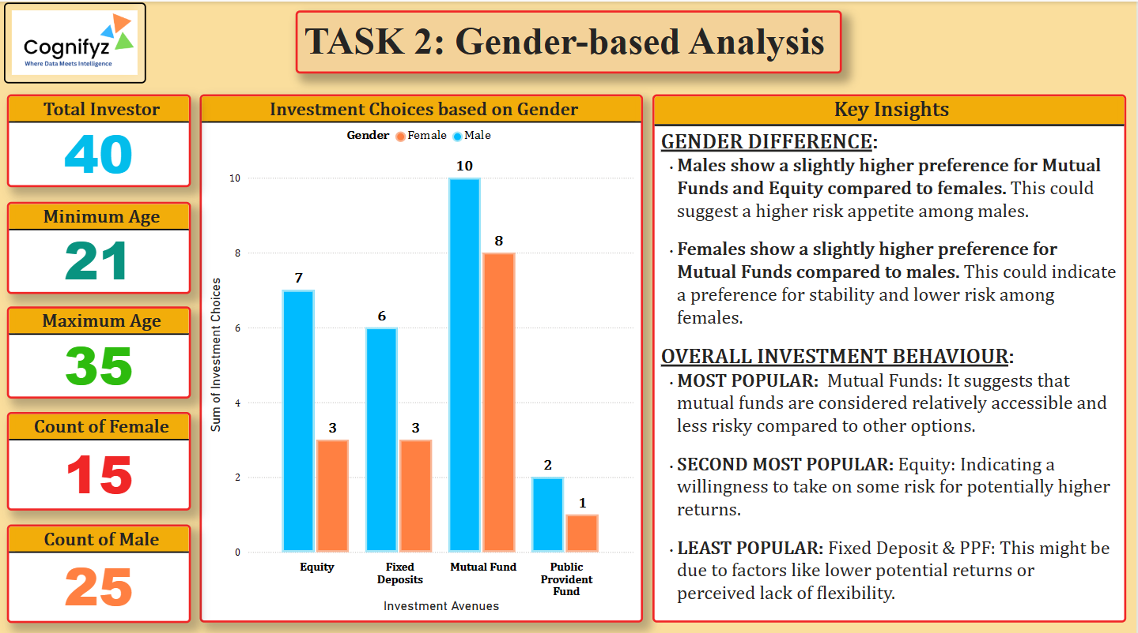
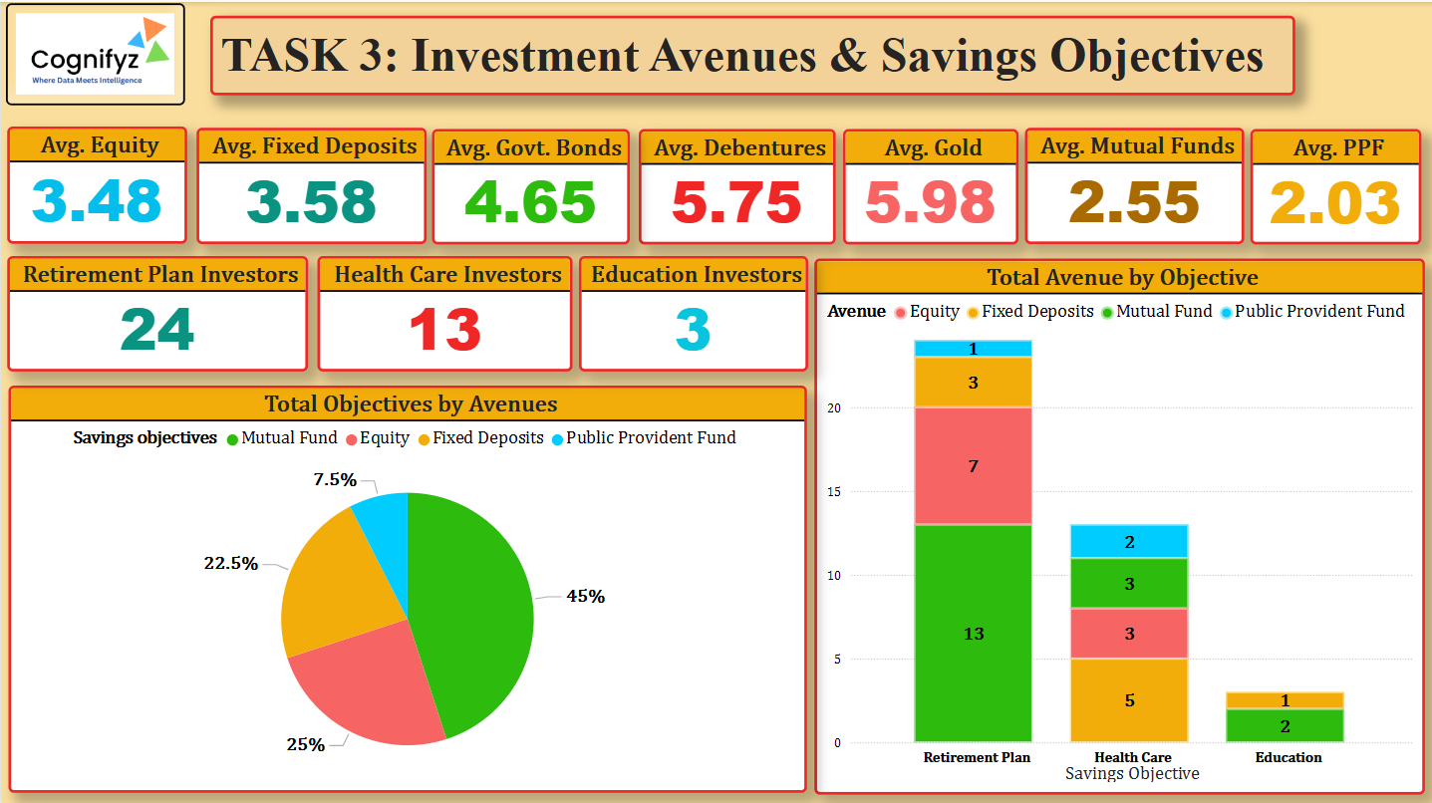
Task 2: Gender-based Analysis
Key Insights:
Gender Difference: Males show a slightly higher preference for Mutual Funds and Equity, suggesting a higher risk appetite. Females show a slightly higher preference for Fixed Deposits and Public Provident Funds, indicating a preference for stability and lower risk.
Overall Investment Behavior: Mutual Funds are the most popular, followed by Equity. Fixed Deposits and PPF are less popular.
Task 3: Objective Analysis
Key Findings:
Retirement Plan is the most common savings objective.
Mutual Funds are the most preferred avenue across different objectives, followed by Equity.

Slide 7
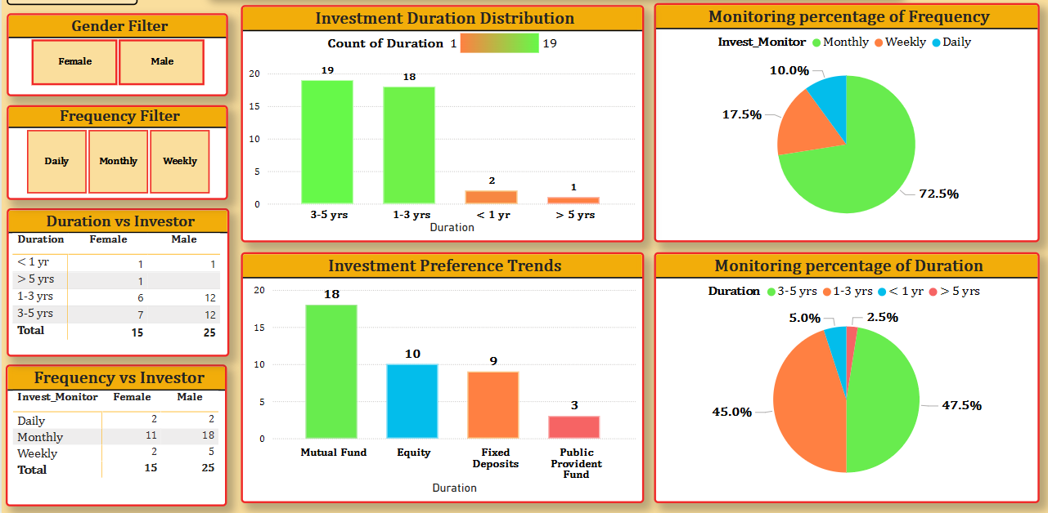
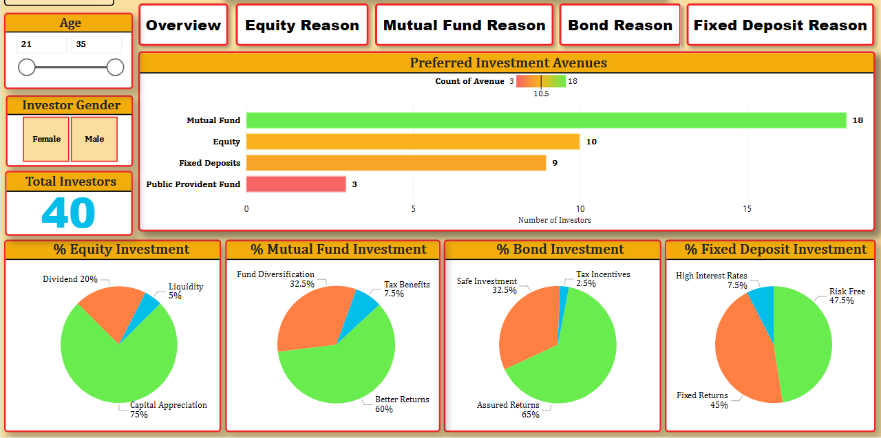
Task 4: Investment Duration and Frequency
Key Findings:
Most investments fall into the '1-3 years' and '3-5 years' duration categories.
Monthly monitoring is the most common frequency (72.5%), followed by Weekly (17.5%) and Daily (10%).
Task 5: Reasons for Investment
Key Findings:
Equity Investment Reasons: Capital Appreciation (75%), Better Returns (60%).
Mutual Fund Investment Reasons: Fund Diversification (32.5%), Dividend (20%).
Fixed Deposit Reasons: Assured Returns (65%), High Interest Rates (7.5%).
Bond Investment Reasons: Risk Free (47.5%), Fixed Returns (45%).

Slide 8
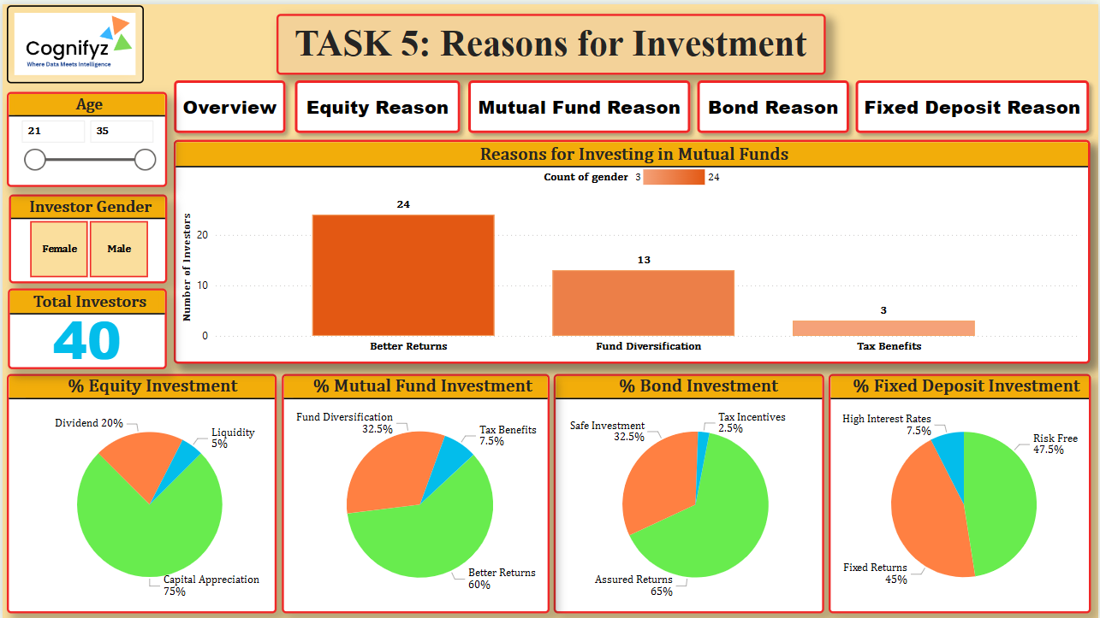
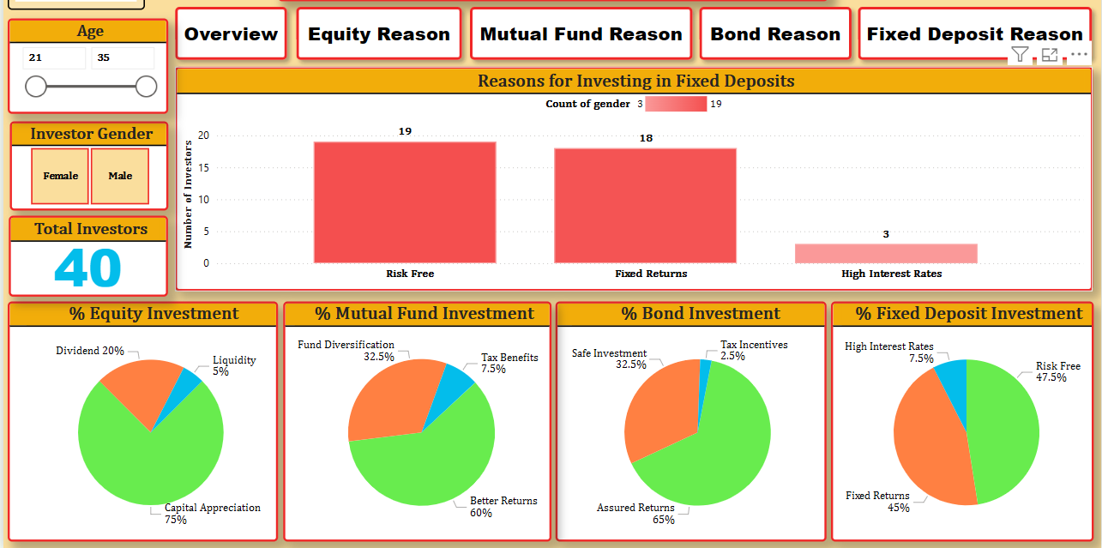
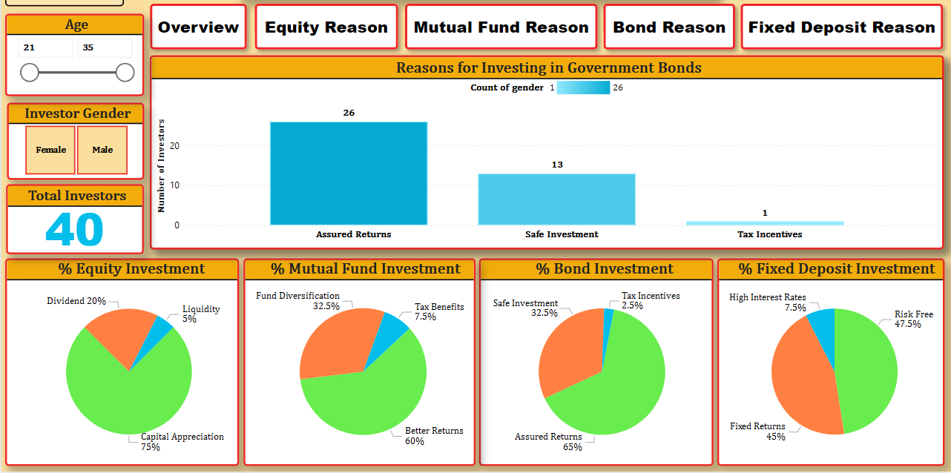
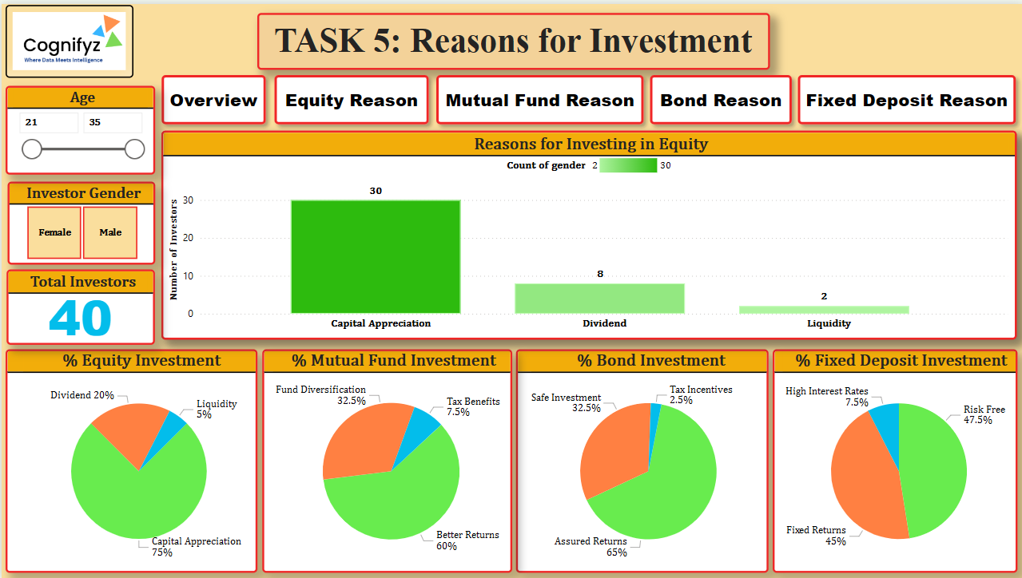
Task 5: Mutual Fund Reason
Task 5: Fixed Deposit Reason
Task 5: Government Bond Reason
Task 5: Equity Reason

Slide 9
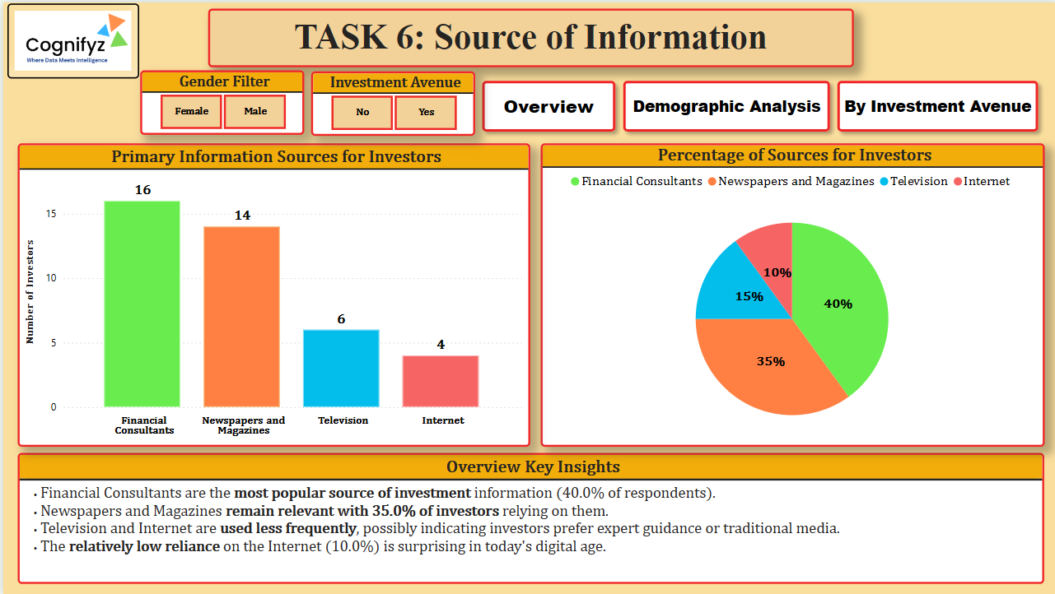
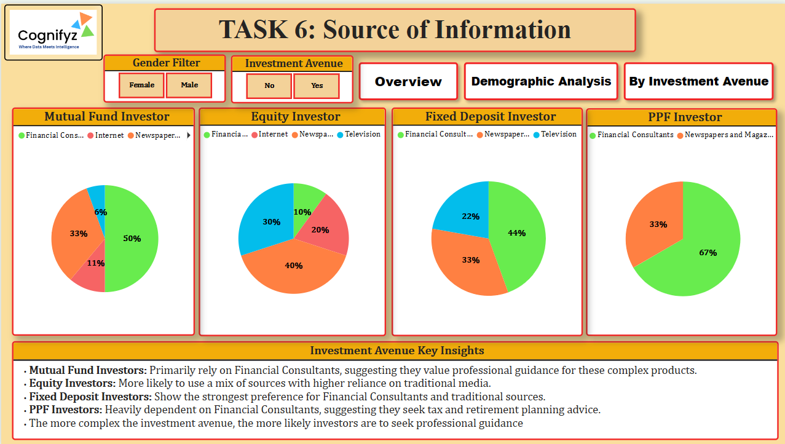
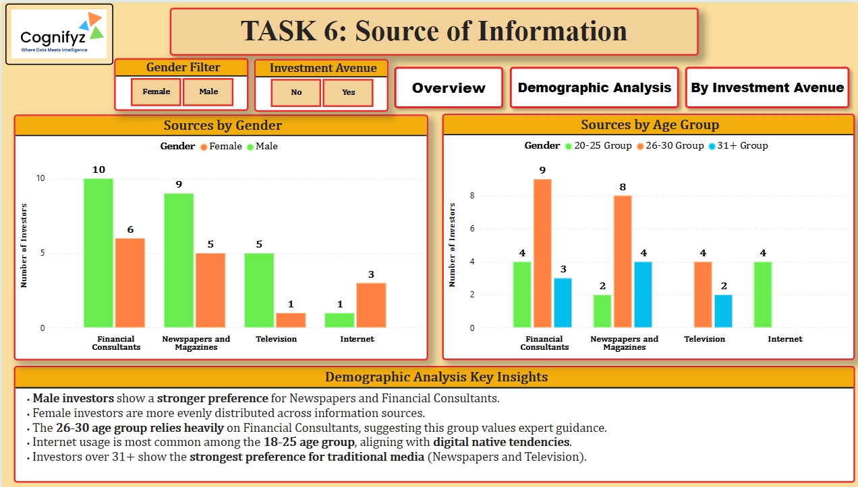
Task 6: Source of Information
Key Findings:
Mutual Fund Investors: Primarily rely on Financial Consultants (50%), then Newspapers (33%), Internet (11%), Television (6%).
Equity Investors: Higher reliance on Newspapers (40%), then Television (30%), Internet (20%), Financial Consultants (10%).
Fixed Deposit Investors: Strongest preference for Financial Consultants (44%), followed by Newspapers (33%), Television (22%).
PPF Investors: Heavily dependent on Financial Consultants (67%), then Newspapers (33%).
The more complex the investment avenue, the more likely investors are to seek professional guidance.
Investment Avenue
Demographic Analysis

Slide 10
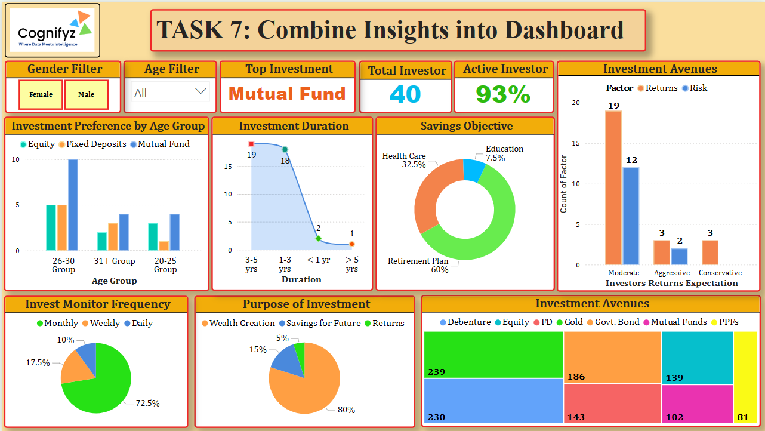
Task 7: Combine Insights into Dashboard
Dashboard Features:
Total Investors: 40
Filters: Age, Gender, Source, Avenue
Visualizations: Investment Preference by Age Group, Purpose of Investment, Investment Duration, Invest Monitor Frequency, Investment Avenues, Savings Objective, Investors Returns Expectation

Slide 11
Conclusion
This project provided a comprehensive analysis of investment behavior. Key takeaways include the prevalence of Mutual Funds and Equity, gender-specific investment preferences (males preferring riskier assets, females preferring stable ones), the dominance of Retirement Plans as a savings objective, and the significant role of financial consultants for complex investment avenues. The interactive dashboard serves as a powerful tool for further exploration and understanding of these insights.

Slide 12
Recommendations
Based on the findings, the following recommendations can be made:
Targeted Marketing: Investment product marketing can be tailored based on gender and age group, highlighting relevant benefits (e.g., stability for females, growth for males).
Educational Initiatives: For less popular avenues like Fixed Deposits and PPFs, educational campaigns can emphasize their unique benefits (e.g., assured returns, tax benefits) to broaden investor appeal.
Information Dissemination: Given the reliance on financial consultants for complex products, partnerships with such professionals can be beneficial. For equity investors, traditional media remains an important channel.
Product Development: Consider developing products that cater to the most common savings objective (Retirement Plan) and offer flexible duration options to align with investor preferences.
Digital Engagement: While financial consultants are crucial, increasing online presence and providing accessible digital resources can further support investor information gathering, especially for the younger demographic.
This report serves as a valuable resource for financial institutions, advisors, and investors seeking to understand the dynamics of investment behavior.

Slide 13
Thank you
Paromita Saha
Intern Id: ITID0902
paromitasaha0720@gmail.com

